Slide 1
Preventing Collusion in Cloud Computing Auctions
Shunit Agmon, Orna Agmon Ben-Yehuda, Assaf Schuster
Technion – Israel Institute of Technology
Notes:
Joint work with Orna and Assaf. (Or: dr. and prof? TODO: find out.)

Slide 2
Resource-as-a-Service (RaaS)[1]
A dominant trend in cloud computing.
The principles of RaaS:
Fine resource granularity.
Fine time granularity: per second.
Using economic mechanisms to provision resources.
The Rise of RaaS: the Resource-as-a-Service cloud, Agmon Ben-Yehuda et. al.,
Communications of the ACM (CACM), July 2014
Notes:
Instead of offering bundles of resources as in the IaaS paradigm, RaaS providers offer for rent separate resources, in fine time granularity.
As providers use more economic mechanisms to control clients’ access to resources, clients will use economic software agents to buy computing resources.

Slide 3
Horizontal vs. Vertical Scaling
Horizontal Scaling:
Buying more VMs
Vertical Scaling:
Buying more resources
Notes:
Horizontal scaling (buying more VMs)
Vertical scaling (buying more resources for the same VMs – CPU, RAM, bandwidth)

Slide 4
RaaS is Prevalent in Horizontal Scaling
Paying per use in granularity of seconds

Slide 5
RaaS is Prevalent in Horizontal Scaling
Using economic mechanisms to allocate VMs
2009
EC2 Spot Instances
2015
Preemptible VMs
2017
low-priority VMs
2017
Spot Market
Probably 2017
Preemptible instance
Notes:
Spot instances – provider sells leftover resources at large discounts. The instance may be preempted if the provider needs the capacity back.
The price is a result of the market supply and demand.
For example – Alibaba - The user bids for an instance. If the bid is higher than the market price, the machine is created/keeps running.
Uniform auction – Similar to 2nd price auction, in the sense that the bidders don’t pay their bid.

Slide 6
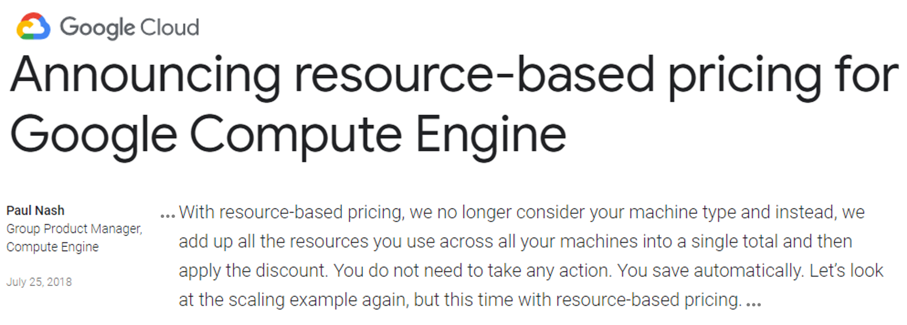
RaaS is Emerging in Vertical Scaling
Billing in fine resource granularity
https://cloud.google.com/blog/products/gcp/announcing-resource-based-pricing-for-google-compute-engine
Notes:
In vertical scaling, we also see the principles of RaaS emerging.
Not 2 months ago

Slide 7
RaaS is Emerging in Vertical Scaling
Emergence of economic mechanisms: burstable instances.
Provide a baseline level of CPU performance with the ability to burst above that baseline level.
Burstable Performance Instances
B-series burstable VMs
Burstable instances (t5)
F1-micro bursting
The ability to burst is usually governed by credits. The mechanism slightly differs for each provider.
The vertical scaling world is in search of economic mechanisms.
Notes:
Mechanisms differ by credits and baseline levels.
Burstable:
Alibaba: credits expire after 24 hours. Baseline is 10% or 15%.
https://www.alibabacloud.com/help/doc-detail/59977.htm
Azure: Credits are accrued up to a maximum set by the machine type. Baselines range from 10% to 135%.
https://docs.microsoft.com/en-us/azure/virtual-machines/windows/b-series-burstable
AWS: Credit max is the amount that can be accumulated in 24 hours, but credits do not expire as long as the machine is running.
https://docs.aws.amazon.com/AWSEC2/latest/UserGuide/t2-credits-baseline-concepts.html
GCP also have burstable instances but no credits. Bursting happens automatically.
https://cloud.google.com/compute/pricing

Slide 8
VCG Auctions – Vickrey, Clarke, Groves
Bidders submit sealed bids for auctioned goods.
The auctioneer allocates the goods to the bidders who value them most.
Winners are charged for the damage they caused others.
Bidders are incentivized to bid with their true valuation.
As a result,
VCG auctions maximize Social Welfare (sum of participants’ valuations).
But – calculating the social welfare optimal allocation is NP-hard.
Notes:
We believe a suitable mechanism for RaaS clouds would be based on a VCG auction.
First bullet – the bids represent their full valuation functions.
NP-hard – so VCG auctions would need some adjustments in order to be applied to real world problems.

Slide 9
Simplified Memory Progressive Second Price (SMPSP) Auction
Lazar & Semret (1998) – Progressive 2nd price (PSP) for bandwidth
Maille & Tuffin (2004) – PSP for bandwidth with multi-bids
Agmon Ben-Yehuda et. al. (2014) – Ginseng – Memory Progressive Second Price (MPSP)
All of the above use VCG-like mechanisms to allocate divisible goods.
This work builds on SMPSP, which is the core of all these works.
Notes:
Several works built VCG-like mechanisms to allocate divisible goods, adjusting VCG to real-world scenarios.
The first two offered mechanisms for bandwidth allocation, and the third offered a mechanism for Memory allocation.
We will now describe the SMPSP mechanism.

Slide 10
SMPSP – VCG-like repeated memory auction
Host
Guest
Notify guests about allocation and payments
Announce auction round start and available RAM
The guest is willing to pay a unit price of p for a quantity of up to q.
Bid with (p, q)
Calculate social
welfare optimal
allocation ($O(n^{2}$))
Notify guests about allocation and payments
Announce auction round start and available RAM
Notes:
In each round, each guest bids with a pair (p,q)
The bid language is what makes it VCG-like. The complexity is lower than VCG.

Slide 11
Ginseng’s Allocation and Billing
Total memory
1
1
2
P (bid price)
3
4
5
Q (memory quantity)
Notes:
Explain axes.
The host sorts the bids by the unit price (descending) and allocates the memory in that order.
Guests are billed by the damage they cause others.
As we mentioned, bidders are incentivized to bid truthfully. But VCG in general and SMPSP in particular are not collusion proof.

Slide 12
Example: Collusion that Harms Social Welfare
p=15¢
Total memory
Hey Alice, willing to disappear? I’ll give you 7¢..
Without Collusion:
Alice’s profit: 5¢
Bob’s profit: 0¢
Social Welfare: 15¢
With Collusion:
Alice’s profit: 7¢
Bob’s profit: 3¢
Social Welfare: 10¢
Alice
p=10¢
Bob
P (bid price)
q = 10GB
q = 10GB
Q (memory
quantity)
Notes:
Clients don’t know/ care about SW, so they may harm it to increase their profits
Finding out who is on the same machine – “Hey, you, get off my cloud..” – Ristenpart, Tromer, Shacham, Savage, 2009

Slide 13
Related Work – Collusion Schemes
Requires a trusted agent or 3rd party
Bidding ring, with a secondary resource market behind the host’s back.
Graham & Marshall 1987, Mailath & Zemsky 1991, McAfee & McMillan 1992
Sharing private valuations with all ring members, and playing a cooperative game to redistribute resources and split profits.
Bachrach, 2010
Price shading – bribing a bidder to decrease the bid price.
Eso & Schummer, 2004, Rachmilevitch 2015
Bid rotation – bidding in turns
Aoyagi 2003 & 2007, McAfee & McMillan 1992 , Blume & Heidhues 2008, Skrzypacz & Hopenhayn 2004, Rachmilevitch 2013
VMs can’t easily redistribute resources
Requires complete trust among colluders
Harm social welfare
Notes:
Let’s review some previous works on collusion schemes.

Slide 14
Our Coalition Mechanism
Does not require trust among colluders.
The host acts as the trusted 3rd party.
The resources are distributed through the host.
Maintains the social welfare, and thus the allocation efficiency.

Slide 15
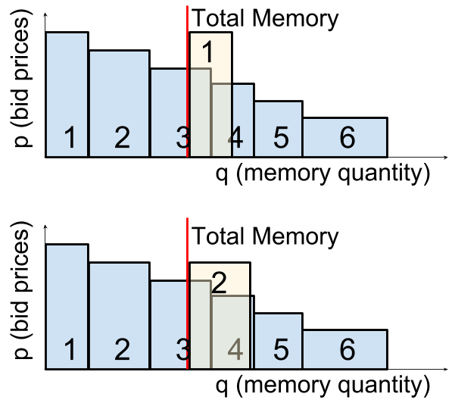
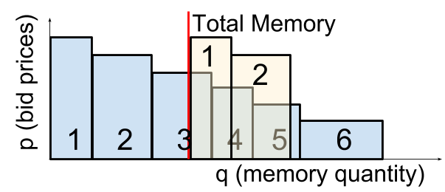
Our Coalition Mechanism
Two or more guests can ask the host to be billed as one, creating additional profit:
Paying Alone
Paying Together

Slide 16
Our Coalition Mechanism
Host
Guest
Notify about allocation, payments and discounts,
respected coalitions
Announce auction round start and available RAM
Negotiate with
other guests
Bid with (p, q, profit parts)
Example:
{A: 0.25, B:0.75}
Calculate social
welfare optimal
allocation
Notify about allocation, approved coalitions,
payments and discounts
Announce auction round start and available RAM
Notes:
לשתות מים

Slide 17
The Guest–Guest Protocol
Guests negotiate the division of profits, then tell the host.
A
C
B
Coalition size: 2
Coalition size: 1, Offer: {A: 0.4, C:0.6}
Counter Offer: {A:$2/3$, C:$1/3$}
Accept
The offer was accepted; finalize the deal
Final1, members: {A:0.5, B:0.5}
Final2, members: {C:1}
Notes:
Normalization:
2*orig_alpha*(N_partner/N_total)

Slide 18
Guest Negotiation Strategy – Offer Value, Accept Threshold
OV=0.4
AT=0.3
OV=0.3
AT=0.5
0.4?
0.3
$0.4<AT$ $⇒$ Reject
No.
$$0.3≥AT$$
$⇒$Accept
?
OK
Notes:
Negotiation strategy is a pair (OV, AT)
Offer value (OV) – the first offer a guest makes to a partner
Accept threshold (AT) – the minimal value a guest is willing to accept.

Slide 19
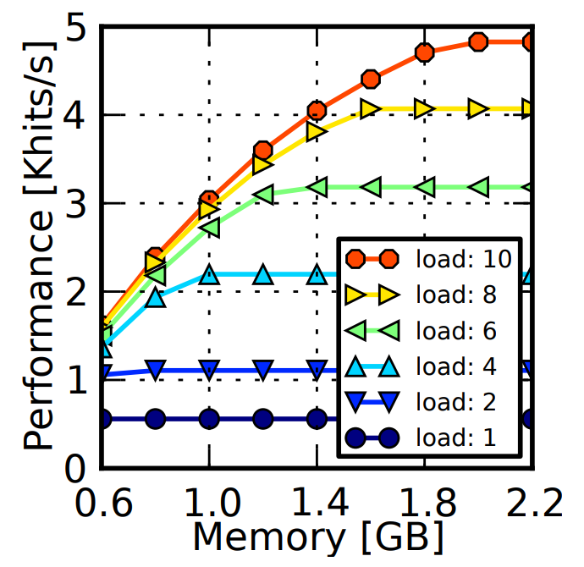
Experimental Setup
Ginseng system with 10 VMs on a single host.
Each guest runs elastic-Memcached (concave performance function).
Guest valuations were linear and drawn from a Pareto distribution with index 1.36.
Available RAM for auction - $\frac{1}{3}$ of aggregate demand, to create some resource pressure.
Notes:
Law of diminishing returns, common assumption in auction schemes.
Why use this? Because when valuation function are concave, Ginseng is equivalent simplified MPSP.

Slide 20
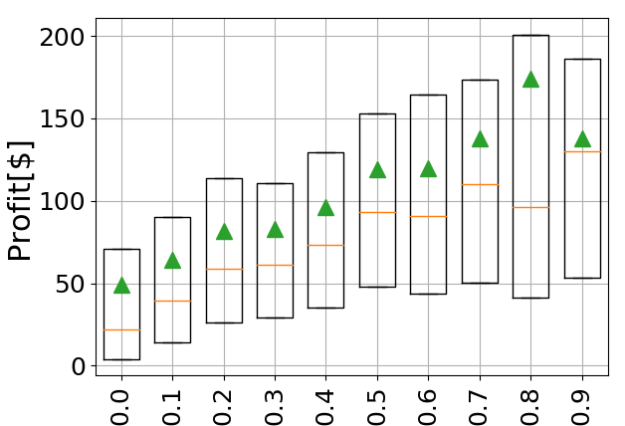
Reasonable Negotiation Strategy
Offer Value
Accept Threshold
Notes:
Ov~Uni(0,1)
At~uni(0,1-ov)
Under the assumption of static strategies, we found probable strategies for rational guests – more on that in the paper.
The exact values depend on the profile strategy distribution.
We used them to evaluate the coalitions mechanism.
This is a fertile ground for research on dynamic strategies.

Slide 21
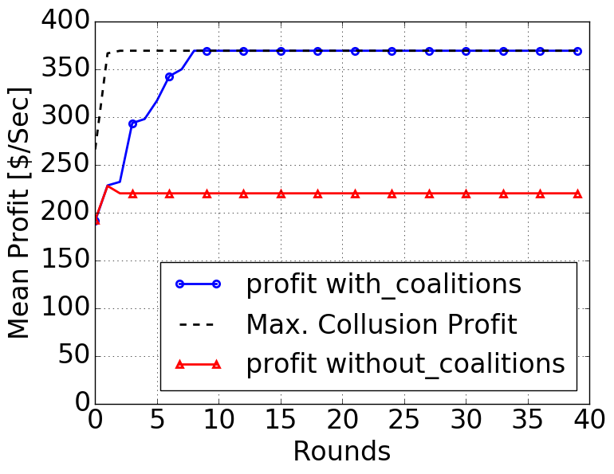
Average Profit Increased, Social Welfare Maintained
Profit with coalitions
Maximal collusion profit
Profit without coalitions
Notes:
The first thing to note is that the social welfare remained the same with coalitions.
The second can be seen in the graph, of the average guest profit over experiment rounds.
The average profit increases as coalitions are formed, until the maximal possible collusion profit.
Max. collusion profit is what we would get if colluding guests trusted each other completely with their valuations, chose designated winners and their exact bids and all the non-winners bid with 0 (so there is no bill).
More in the paper: different host policies and how coalition size affects the average profit of a coalition member.

Slide 22
Conclusion
The coalition mechanism increases guests’ average profit up to the maximum possible collusion profit.
If the provider enables coalitions, it will be less profitable for guests to collude and harm the social welfare and the allocation efficiency.
The coalition mechanism is applicable on any VCG or VCG-like auction.
There is fertile ground for research on dynamic guest strategies.
Notes:
2nd bullet:
By increasing the guest profit through coalitions, the potential profit from harmful collusion schemes is decreased, and guests have less incentive to collude and harm SW.

Slide 23
Thank you!
?
?
?
?
Feel free to contact me at:
shunita@cs.technion.ac.il
http://shunita.cswp.cs.technion.ac.il/
?
?
Questions?
Notes:
Awesome icons

Slide 24
Extra Material

Slide 25
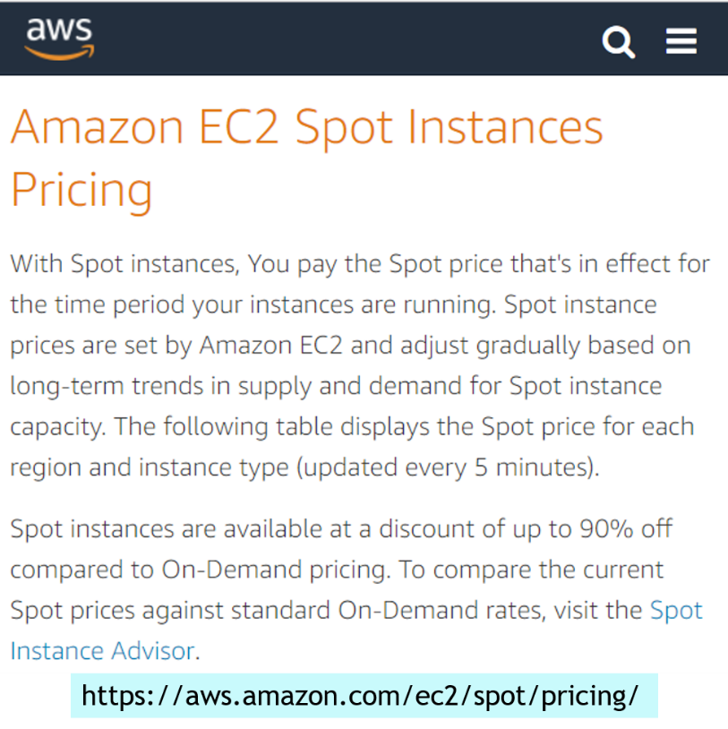
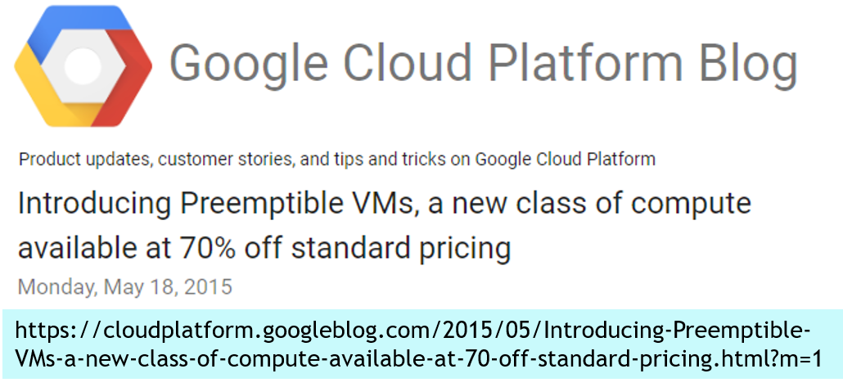
RaaS is Prevalent in Horizontal Scaling
Using economic mechanisms to allocate VMs
Since December 2009
Since May 2015
Since July 2017
Notes:
Examples of aucitons in horizontal scaling
Uniform auction – Similar to 2nd price, in the sense that the bidders don’t pay their bid.
TODO: find out the timeline. Amazon is from 2009. GCP preemptible from May 2015. Packet probably since 2017. Alibaba? Not sure.
TODO: organize and add animation (each splash separately).
https://devops.com/packet-launches-edge-compute-service-power-distributed-workloads/

Slide 26
(Backup)VCG Auctions – Vickrey, Clarke, Groves
Bidders submit sealed bids for auctioned goods.
The auctioneer allocates the goods to the bidders who value them most.
Winners are charged for the damage they caused others (exclusion-compensation principle).
Bidders are incentivized to bid with their true valuation.
Thus:
VCG auctions maximize Social Welfare.
But – bidders may collude to gain more profit at the expense of Social Welfare (and efficiency).
Notes:
We believe a suitable mechanism for RaaS clouds would be based on VCG.
Second bullet:
Calculating the SW-optimal allocation is NP-hard.
Removed (exclusion compensation principle) from bullet 3

Slide 27
Ginseng
Ginseng is an example of a RaaS system where the resource is RAM, based on a VCG-like repeated auction.
In each round, each guest bids with a pair (p,q)
The guest is willing to pay a unit price of p for a quantity of up to q.
The host sorts the bids by the unit price (descending) and allocates the memory in that order.
Guests are billed by the damage they cause others.
Notes:
Ginseng – presented by Orna Agmon Ben-Yehuda, Liran Funaro and Assaf Schuster in 2014

Slide 28
Guest Strategy and Host Policy
Without coalitions, the unit bill estimation is the same whether the quantity is increased or not.
The guest bids for the quantity that maximizes its profit.
$profit\left(q\right)=valuation\left(q\right)−est.bill(q)$

Slide 29
Guest Strategy and Host Policy
With a coalition the bill may be lower and even negative.
The agent estimates that the bill will be lower as the quantity grows.
It will ask for the entire available memory, and harm the Social Welfare.

Slide 30
Guest Strategy and Host Policy
The host’s No-Increase policy causes the agent to fear the break of the coalition in case of quantity increase.
With this policy, the guests continue to bid as they did without coalitions, maintaining Social Welfare.
Sneaky guests can increase their quantity before joining a coalition – we still don’t have a solution for that.

Slide 31
Guest Strategy and Host Policy (2/2)
Outside guests can “fake an injury” and extort more money from the inside guests in their coalition.
Solution: host does not allow outside guests
Also, smart enough guests should not do this as they might actually get memory and get billed
With these policies, the guests continue to bid as they did without coalitions.
Notes:
עדיין יש את הבעיה של להכנס לקואליציה, לצאת, להגדיל ולחזור. להוסיף לשקף, ולהגיד שעדיין לא מצאנו פתרון לזה.

Slide 32
Guest Negotiation Strategy
Negotiation strategy is a pair (OV, AT)
Offer value (OV) – the first offer a guest makes to a partner
Accept threshold (AT) – the minimal value a guest is willing to accept.
Under the assumption of static strategies, we found probable strategies for rational guests – more on that in the paper.
We used them to evaluate the coalitions mechanism.
Notes:
Visualize
Almost all this text should be in the notes.
This is a fertile ground for research on dynamic strategies.

